Slide 1
Contents
Introduction
Data Independence
Logical Independence
Physical Independence

Slide 2
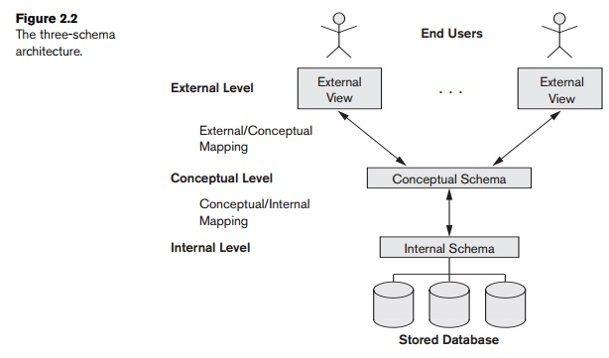
Three Tier Architecture

Slide 3
Data Independence
Data Independence is defined as a property of DBMS that helps you to change the Database schema at one level of a database system without requiring to change the schema at the next higher level.
Data independence helps you to keep data separated from all programs that make use of it.
There are two ways with which we can have data independence.
        Physical Data Independence
        Logical Data Independence

Slide 4
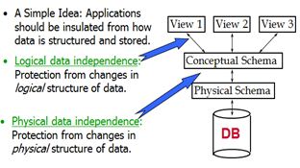
Data Independence

Slide 5
Physical Data Independence
Physical data independence helps you to separate conceptual levels from the internal/physical levels.
It allows you to provide a logical description of the database without the need to specify physical structures.
With Physical independence, you can easily change the physical storage structures or devices without an effect on the conceptual schema.
Any change done would be absorbed by the mapping between the conceptual and internal levels.
        Physical data independence is achieved by the presence of the internal level of the database and then the transformation from the conceptual level of the database to the internal level.

Slide 6
Physical Data Independence
Examples of changes under Physical Data Independence
Due to Physical independence, any of the below change will not affect the conceptual layer.
Using a new storage device like Hard Drive or Magnetic Tapes
Modifying the file organization technique in the Database
Switching to different data structures.
Changing the access method.
        Modifying indexes.
        Changes to compression techniques or hashing algorithms.
        Change of Location of Database from say C drive to D Drive

Slide 7
Logical Data Independence
Logical Data Independence is the ability to change the conceptual scheme without changing
      External views
      External API or programs
Any change made will be absorbed by the mapping between external and conceptual levels.
When compared to Physical Data independence, it is challenging to achieve logical data independence.

Slide 8
Logical Data Independence
Examples of changes under Logical Data Independence
Due to Logical independence, any of the below change will not affect the external layer.
Add/Modify/Delete a new attribute, entity or relationship is possible without a rewrite of existing application programs
Merging two records into one
Breaking an existing record into two or more records

Slide 9
Difference between Physical and Logical Data Independence
Logical Data Independence | Physical Data Independence
Logical Data Independence is mainly concerned with the structure or changing the data definition. | Mainly concerned with the storage of the data.
It is difficult as the retrieving of data is mainly dependent on the logical structure of data. | It is easy to retrieve.
Compared to Physical independence it is difficult to achieve logical data independence. | Compared to Logical Independence it is easy to achieve physical data independence.
You need to make changes in the Application program if new fields are added or deleted from the database. | A change in the physical level usually does not need change at the Application program level.
Modification at the logical levels is significant whenever the logical structures of the database are changed. | Modifications made at the internal levels may or may not be needed to improve the performance of the structure.
Concerned with conceptual schema | Concerned with internal schema
Example: Add/Modify/Delete a new attribute | Example: change in compression techniques, hashing algorithms, storage devices, etc

Slide 10
Importance of Data Independence
Helps you to improve the quality of the data
Database system maintenance becomes affordable
Enforcement of standards and improvement in database security
You don't need to alter data structure in application programs
Permit developers to focus on the general structure of the Database rather than worrying about the internal implementation
It allows you to improve state which is undamaged or undivided
Database incompatibility is vastly reduced.
Easily make modifications in the physical level is needed to improve the performance of the system.

Slide 11
Thank
You

